Slide 1
Visitor Pattern

Slide 2
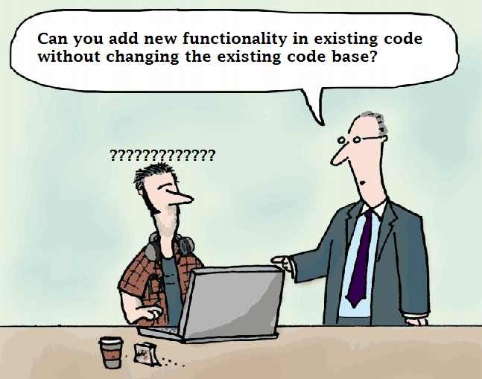
Visitor pattern is a part of behavioral design pattern.
Visitor pattern will not change the current code structure It is used to add the new functionality in existing code.
Classes which holds the new behaviors are commonly known as Visitors.

Slide 3
Sample Problem
Let's take an example Where a program will calculate the price and quantity Food. Now You may find yourself in a situation where you need to make a functional change in price and quantity to a collection of classes but you do not have control over the classes in the hierarchy. This is where the Visitor pattern comes in. The intent of the Visitor design pattern is to define a new operation for a collection of classes (that is the classes being visited) without changing the hierarchy itself.
Here the requirement is to make functional changes in price and quantity where food price should increase by 10% and quantity need to increase by 3.

Slide 4
Key Participants
Visitor - It declares a Visit operation for each class of ConcreteElement in the object structure. The operation's name and signature identifies the class.
ConcreteVisitor -It implements each operation declared by Visitor.
Element- It defines an Accept operation that takes a visitor as an argument.
ConcreteElement -It implements an Accept operation that takes a visitor as an argument.
ObjectStructure- It holds all the element of the data structure as a collection, list or something which can be enumerated and used by the visitors.

Slide 5
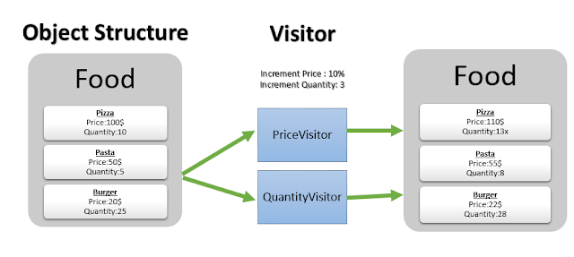

Slide 6
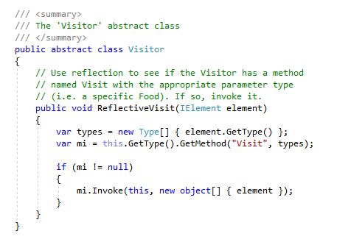
Visitor

Slide 7
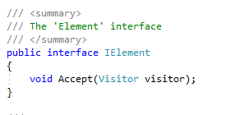
Element

Slide 8
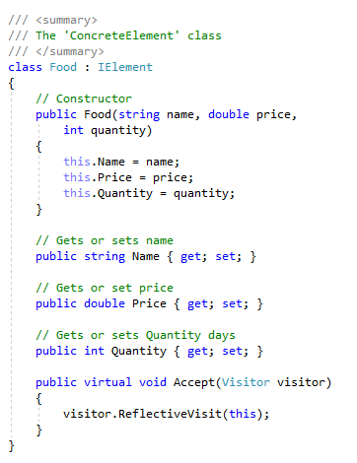
Concrete Element

Slide 9
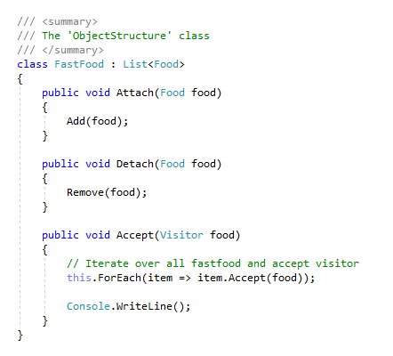
Object Structure

Slide 10
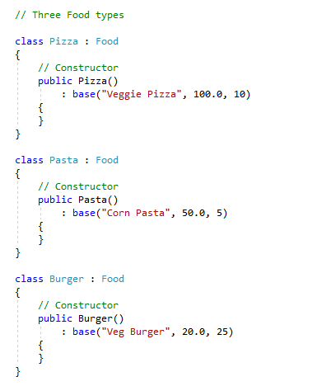
Classes

Slide 11
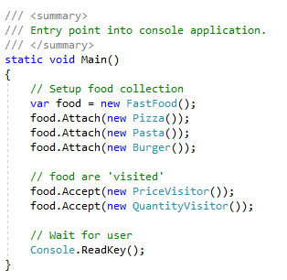
Main Class

